Slide 1
Programming Fundamentals
Lecture 10-11

Slide 2
Objectives
To know about Arrays
To know about contiguous and non-contiguous memory allocation
To know about the types of arrays
To learn the manipulation of arrays

Slide 3
Arrays
An array in C++ is a data structure that can store a series of elements of the same type
An array is used to store a collection of data, but it is often more useful to think of an array as a collection of variables of the same type
All arrays consist of contiguous memory locations. The lowest address corresponds to the first element and the highest address to the last element

Slide 4
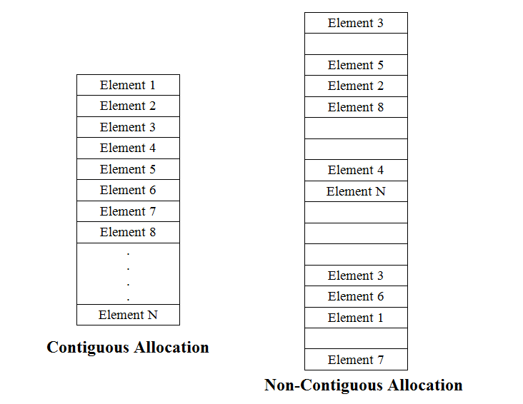
Contiguous Memory Locations
Lowest Address
Highest Address

Slide 5
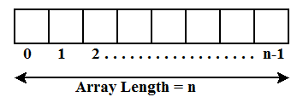
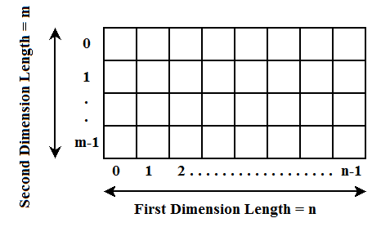
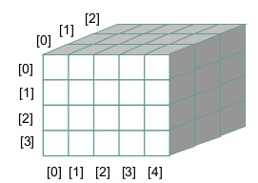
Types of Arrays
Single Dimensional Array
Multidimensional Array
Two Dimensional Array

Slide 6
Declaration of Arrays
Single Dimensional
type arrayName [ arraySize ];
int my_array[10]; // can store 10 elements
Multidimensional
type arrayName[size1][size2]...[sizeN];
float my_array[3][4][5]; // can store 60 elements
Two Dimensional
type arrayName [size1][size2]
double my_array[5][5]; // can store 25 elements

Slide 7
Initialization of 1D Arrays
Single Dimensional Array
A single dimensional array is initialized by separating the array elements with commas inside curly brackets
int values[4]={1, 2, 3, 4}
The array elements cannot be more than the size of array
We can also initialize an array without mentioning the size
int values[ ]={1, 2, 3, 4}

Slide 8
Accessing 1D Array Elements
The array elements are accessed by specifying the index.
For example if we have a single dimensional array as given below
int a[6] = {2, 4, 6, 8, 10, 12};
Then to access the 5th element we need to specify the index like this
int b = a[4]; // the value of b will be 10
Remember that index starts from 0

Slide 9
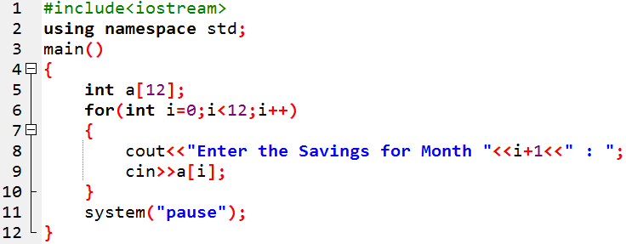
Taking Input in 1D Array
For single dimensional array you need one for loop to take the input from user
The following code will ask the user to enter the savings for 12 months

Slide 10
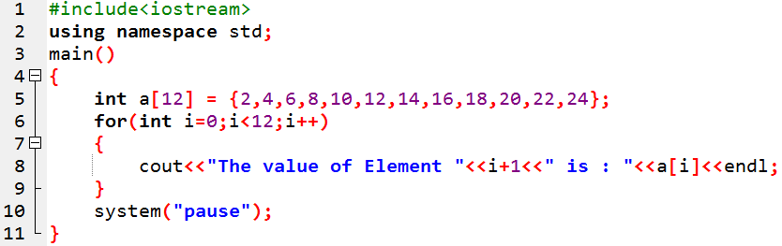
Displaying 1D Array Elements
For single dimensional array we need to use one for loop to display all the elements
The following code will display the elements stored in a single dimensional array

Slide 11

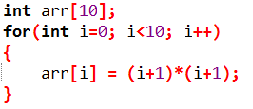
Practice Problem 1
Write a C++ program to store the following data in an array

Slide 12

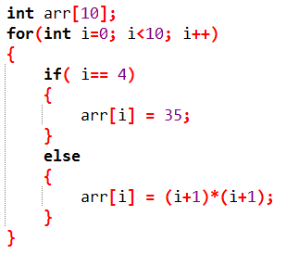
Practice Problem 1 (Modification 1)
Write a C++ program to store the following data in an array

Slide 13

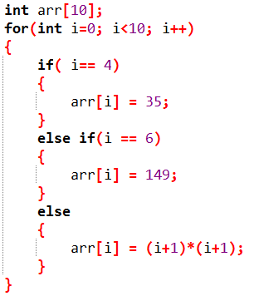
Practice Problem 1 (Modification 2)
Write a C++ program to store the following data in an array

Slide 14

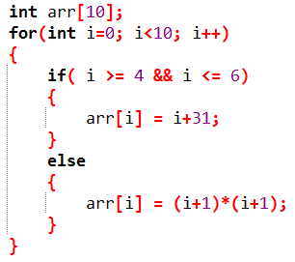
Practice Problem 1 (Modification 3)
Write a C++ program to store the following data in an array

Slide 15
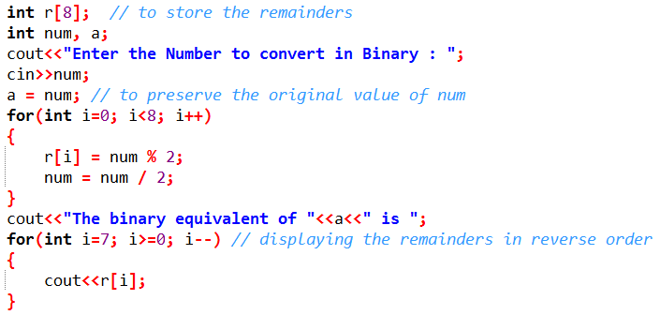
Practice Problem 2
Write a C++ program to convert the decimal number entered by the user in its equivalent binary
For simplicity fix the number to 8 bits only

Slide 16
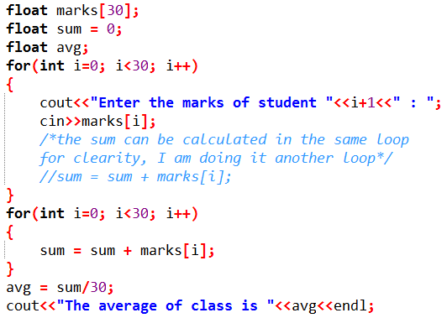
Practice Problem 3
Write a C++ code which should ask the user to enter the marks for 30 students, then calculate the average marks.

Slide 17
2D Arrays
A two dimensional array is an array of 1D arrays
We declare the 2D array as follows
type identifier [no. of 1D arrays][size of each 1D array];
int array[5][10];
The above statement means that we have an array of 5, 1D arrays, where the size of each 1D array is 10 and it can store integer elements

Slide 18
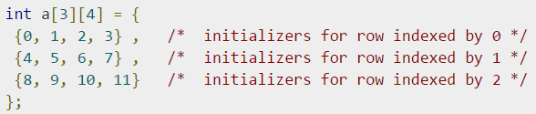
Initialization of 2D Arrays
Two Dimensional Array
Multidimensional arrays may be initialized by specifying bracketed values for each row. Following is an array with 3 rows and each row have 4 columns
The nested braces, which indicate the intended row, are optional. The following initialization is equivalent to previous example:

Slide 19
Accessing 2D Array Elements
For multidimensional array the array elements are accessed by specifying the index of each dimension.
For example if we have a two dimensional array as given below
int a[3][4]={{0,1,2,3},{4,5,6,7},{8,9,10,1}};
Then to access the element of 2nd row and 3rd column we need to specify the index like this
int b = a[1][2]; // the value of b will be 6
Remember that index for each dimension starts from 0

Slide 20
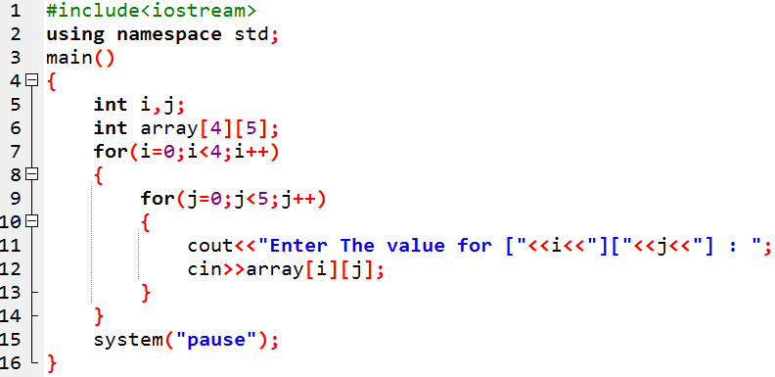
Taking Input in 2D Array
For 2-dimensional array you need to use two for loops to input the data
The following code will ask the user to enter each element of a 4 x 5 array

Slide 21
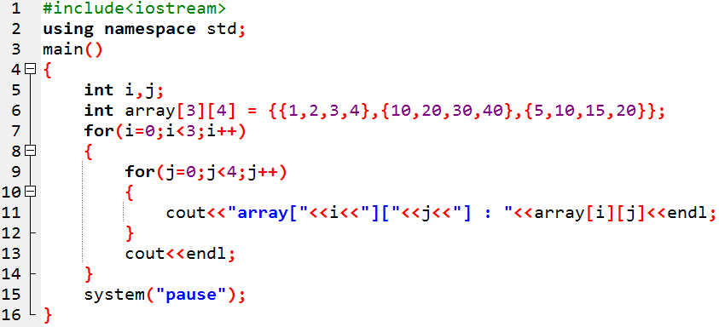
Displaying 2D Array Elements
For two dimensional array we need to use two for loop to display all the elements
The following code will display the elements stored in a two dimensional array

Slide 22
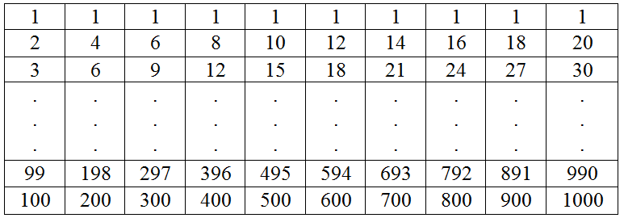
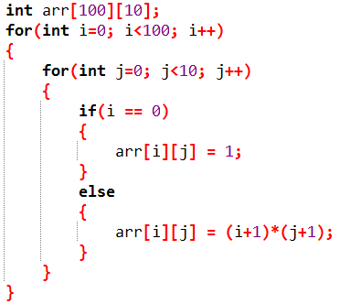
Practice Problem 4
Write a C++ program to store the following data

Slide 23
Practice Problem 5
Write a C++ Program to add two matrices.
Modify the code to take the elements of both matrices from user
Modify the code to take size and elements of both matrices from user
We will do it in class

